Slide 1
Open Day
Floorplan
November 21 2026
Time: 10:00am – 16:30pm

Slide 2
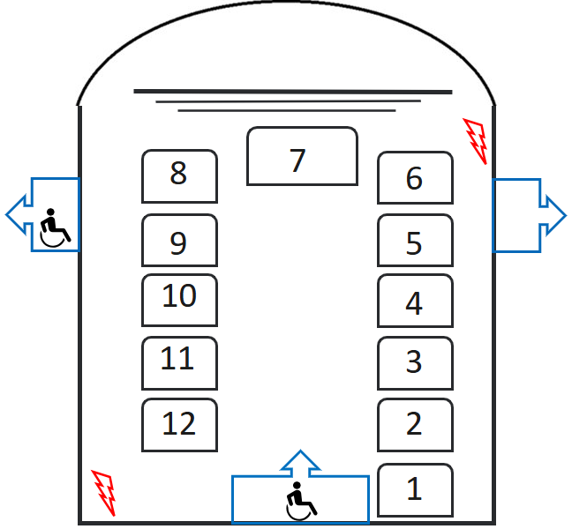

Exam Hall, Front Square – 10 information stands
Build requirements | # of items
Information stands for posters | Two 4m stands for A0 posters (1 for Stand 7 and Stands 2, 3 and 4 are combined with the other 4x1m panel installation) 8 x 3m stands for A0 posters
4 foot tables | 12
Blue tablecloths | 12
Double sockets | 6
Counters/bases for sockets | 3

Slide 3
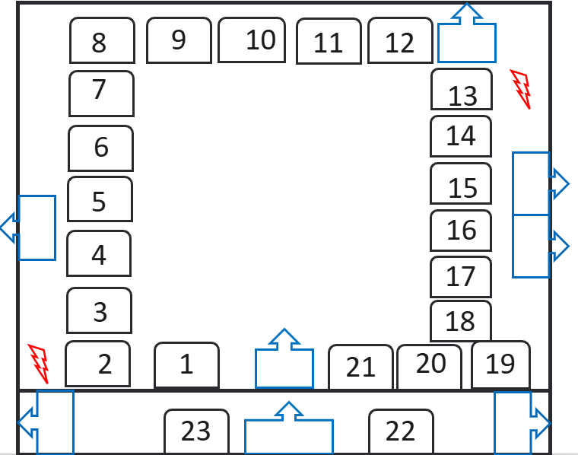
Dining Hall, Front Square – 23 information stands
Build requirements | # of items
Information stands for A0 poster display | 1 x 4m stands 22x 2m stands
4 ft tables | 26
Blue tablecloths | 26
Chairs | 56
Double sockets | 4
Counters/bases for sockets | 3
External 1m pavement sign | 1

Slide 4


Hamilton Building, East End – information stands
Build requirements | # of items
Freestanding Photo panel display stands 2x1m | 20
5ft tables | 2
Blue tablecloths | 2
Chairs | 4
White high stools | 11
White pod tables | 11
Double sockets | 10
Counters/bases for sockets | 3
External 1m pavement sign | 2
HAMILTON FOYER
Lift
CHEM AND BIO LABS

Slide 5
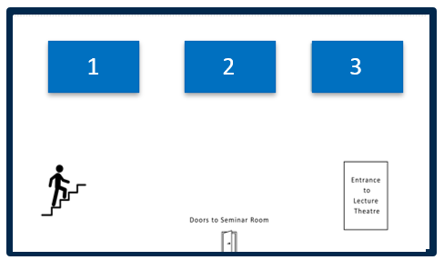
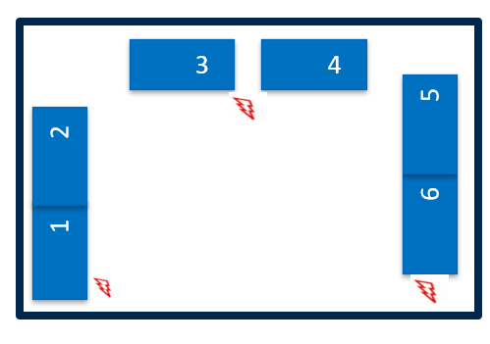
Trinity Biomedical Sciences Institute (TBSI) Basement and Floor 2 – 9 stands
Build requirements - Basement | # of items
Information stands for A0 poster display | 3x 3m stands
4 ft tables | 4
Blue tablecloths | 4
Chairs | 6
BASEMENT
Build requirements - Level 2 KEA | # of items
Information stands for A0 poster display | 2x 3m stands 2 X 4m stands(Stands 1+2 and Stands 5+6 are combined)
4 ft tables | 4
Blue tablecloths | 4
Chairs | 6
Double sockets | 3
Counters/bases for sockets | 3
LEVEL 2

Slide 6
GMB - Debating Chamber and Conversation Room
Build requirements - Debating Chamber | # of items
Information stands for posters | 5 x 2m stands for A0 posters
4 foot tables | 5
Blue tablecloths | 5
External pavement sign | 2
3
2
4
DEBATING CHAMBER
1
5
3
4
5
Build requirements - Conversation Room | # of items
Information stands for posters | 6 x 2m stands for A0 posters
4 foot tables | 6
Blue tablecloths | 6
8
2
CONVERSATION ROOM
6
1

Slide 7
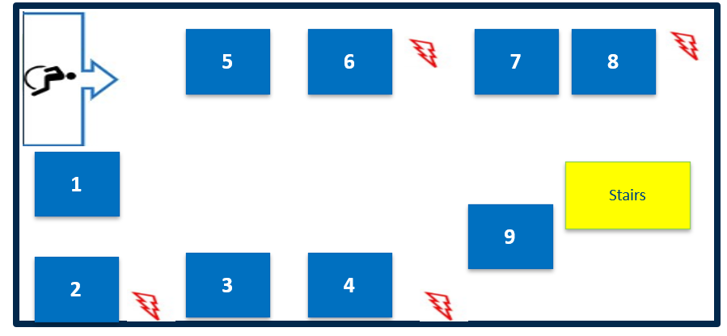


Naughton Institute Ground Floor - 9 information stands
Build requirements - Level 2 KEA | # of items
Information stands for A0 poster display | 4 x 3m stands 4 X 2m stands 1 x 1m stand
4 ft tables | 13
Blue tablecloths | 13
Chairs | 26
Double sockets | 8
Counters/bases for sockets | 4

Slide 8
Beckett Theatre – 5 information stands
2
3
4
Build requirements | # of items
Information stands for A0 poster display | 5 x 2m stands
4 ft tables | 5
Blue tablecloths | 5
Chairs | 10
1
5
BECKETT THEATRE

Slide 9
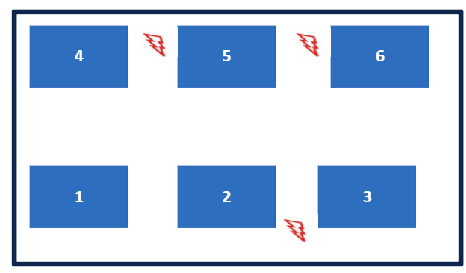
O'Reilly Institute, 1st floor – 6 information stands
Build requirements - | # of items
Information stands for A0 poster display | 1 x 4m stand 5 x 2m stand
5ft tables | 6
Blue tablecloths | 6
Chairs | 12
Double sockets | 3
Counters for sockets | 3

Slide 10
Trinity Business School Foyer
Build requirements | # of items
Information stands for posters | 1 x 3m stand for A0 posters
4 foot tables | 1
Blue tablecloths | 1
Chairs | 2
External pavement sign | 1
Reception
Stairs to theatres
⦿════⦿
⦿════⦿
⦿════⦿
⦿════⦿
1
TBS FOYER

Slide 11
School of Nursing and Midwifery – Foyer and 1st Floor - 6 information stands
1
2
SNM FOYER
Build requirements | # of items
Information stands for A0 poster display | 2 x 1m stands - foyer 4x 2m stands - Room 1.10
3
4
2
ROOM 1.10
1

Slide 12
Dublin University Dental Hospital – 4 information stands
Build requirements | # of items
Information stands for A0 poster display | 4x 2m stands
2
3
1
4

Slide 13
Martin Naughton E3 Learning Foundry – 3 information stands
1
Build requirements | # of items
Information stands for A0 poster display | 3 x 2m stands
4 ft tables | 3
Blue tablecloths | 3
Chairs | 6
2
3

Slide 14
Lloyd Institute – 5 information stands
Build requirements | # of items
Information stands for A0 poster display | 4 x 2m stands 1x 1m stand
External 1m pavement sign | 1
1
2
3
4
FOYER
5

Slide 15
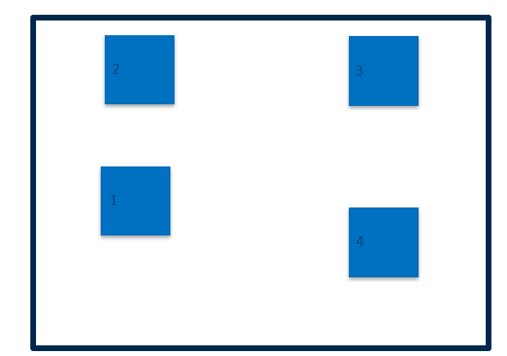
Fitzgerald Building – 3 information stands (own tables supplied)
Build requirements | # of items
Information stands for A0 poster display | 3x 2m stands
Blue tablecloths | 4
External 1m pavement sign | 1

Slide 16
Sports Centre – Main Hall Level 3
Build requirements | # of items
Temporary carpeting of Main Hall flooring for event (810sqm) | 1
Chairs - theatre style | 403
5 foot tables | 3
Tablecloths | 3

Slide 17
Additional External Campus Build Requirements
Build requirements | # of items
Branded pagoda tents (3x3m) with non-slip flooring | 4
1.5m branded counters with shelves | 12
White high stools | 14
Installation of 1500mm x450mm temporary event signage to railings (foamex) | 5
Large teardrop flags (installation and takedown only – these are stored on site) | 10
External crowd barriers outside Sports Centre | 20
2m branded event wayfinding signage | 13
Retractable 1m Queue barrier system | 40m in Front Square 20m in Arts Building 20m in Business School

