Slide 1
ESPD-Online
EU-Supply - Supplier manual

Slide 2


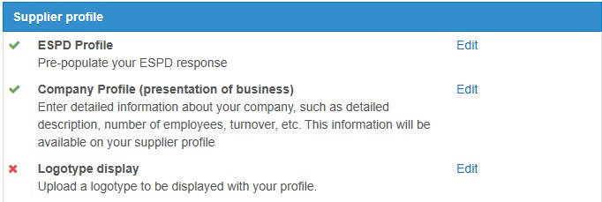
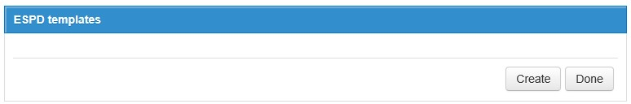
Espd templates
To create a new template for your espd-response log on to the system and navigate to your company administration page and click edit espd profile, Please note that you need to be a company administrator to be able to create or edit a template.
Please note that you can only use these templates in a response if either the contracting authority or your supplier company has payed for this service in the eu-supply system.

Slide 3
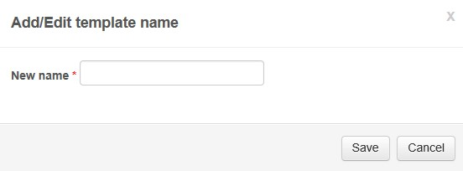
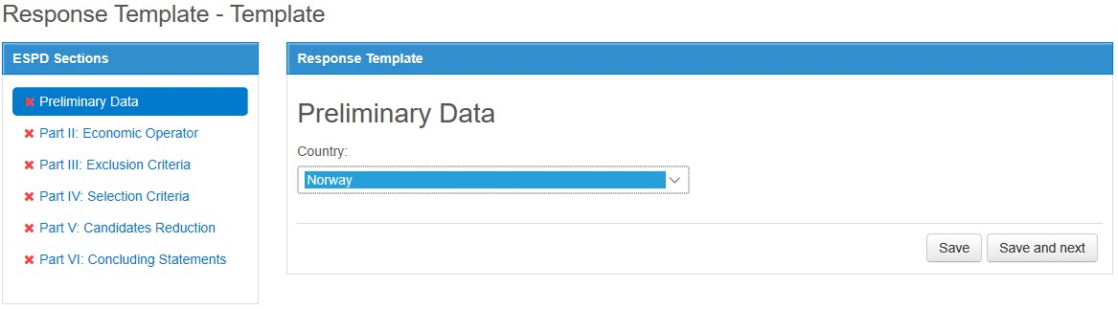
Espd templates
Give your template a name
Select your country and proceed to fill out every section of the form

Slide 4
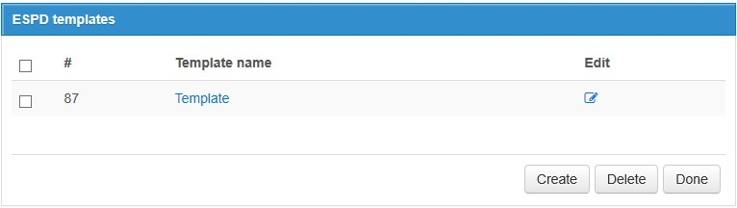
Espd templates
To change the name of your template click the button below ’edit’
To change the answers of your template click its name

Slide 5
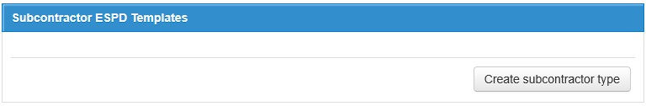
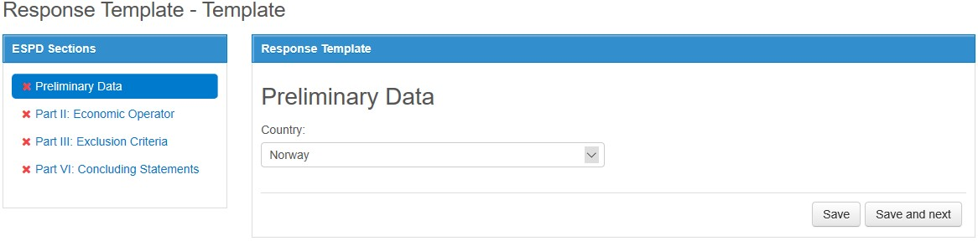
Espd templates
If you are a subcontractor, use the create subcontractor type button
Select your country and proceed to fill out every section of the form

Slide 6
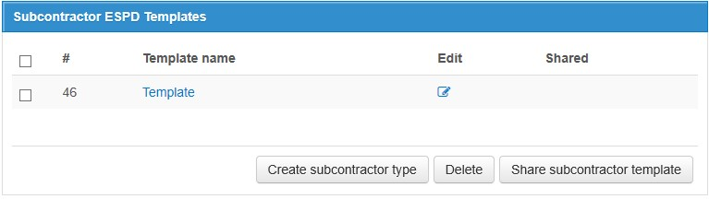
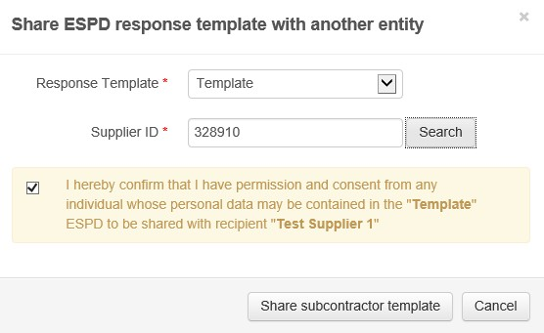
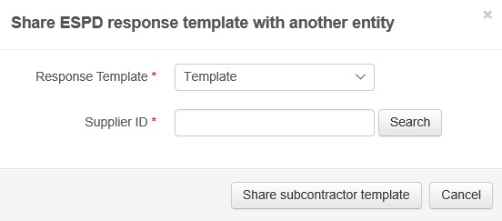
Espd templates
To share your subcontractor template with the main contractor click ’share subcontractor template’
Supplier id can be found under administration -> company administration of the main contractor and is also reffered to as ’ctm id’
Select which template to share and enter the main contractors supplier id, then click share subcontractor template

Slide 7
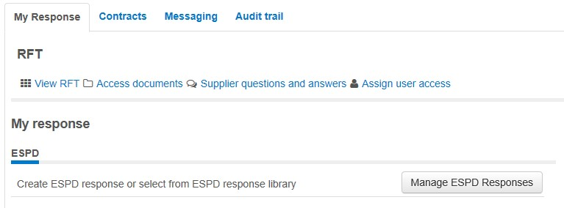
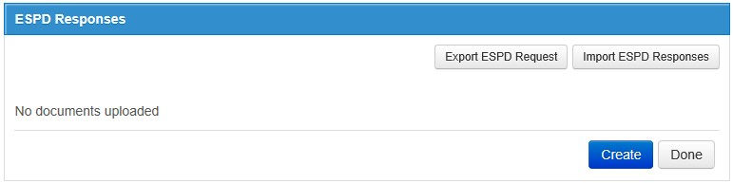
Espd-Response delivery
Click manage espd response on the main page of the tender you are working with
If the contracting authority or your company has payed for the espd service you can now create your response
Please note that you can still export the .xml file if you want to.

Slide 8
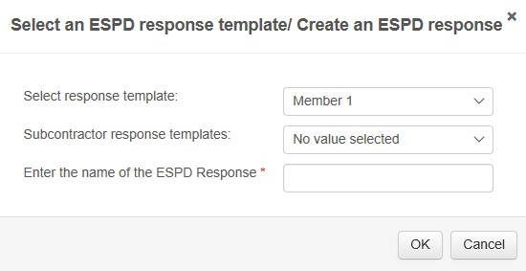
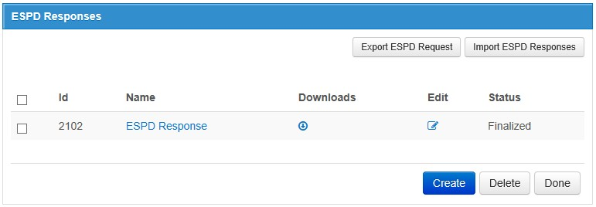
Espd-Response delivery
When clicking create you get the option to choose one of your own templates, a subcontractor template or create a brand new response without a template. You can create as many responses as you need, if you have multiple subcontractors for instance.
When you have finished your response(s) make sure the status is ’finalized’

Slide 9
Espd-Response delivery
You are now done with handling your espd response
If you have any further questions please contact eu-supply support

